Slide 1
Design and Analysis of Algorithms
Lecture 8 – pg 197
Instructor: Mehak Riaz Khan
Email: Mehak.riaz@kiet.edu.pk

Slide 2
Designing
Many approaches
Insertion and Selection sort algorithm used the incremental approach
One of the powerful approach is the divide and conquer.

Slide 3
Divide-&-Conquer Approach
Divide the problem into sub problems,
Conquer the problems by solving them recursively
Combine the solutions to the sub problems into the final solution.

Slide 4
Merge Sort
Divide: divide the n element input into two subproblems
Conquer: sort the two sequences recursively,
Combine: merge the two sorted subsequences

Slide 5

Merge Sort
Divide the input into:

Slide 6
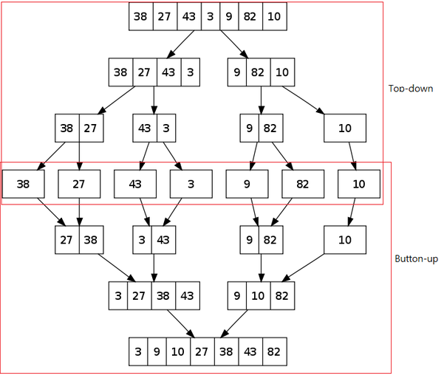

Slide 7
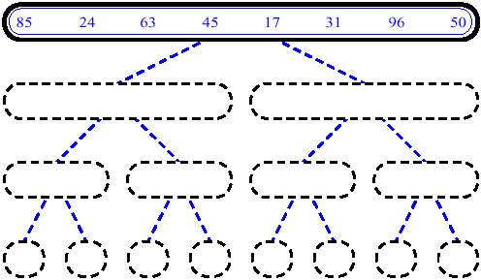
MergeSort (Example) - 1

Slide 8
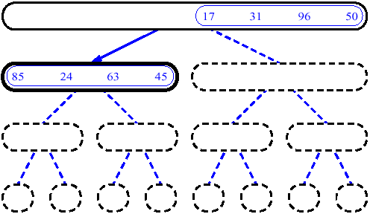
MergeSort (Example) - 2

Slide 9
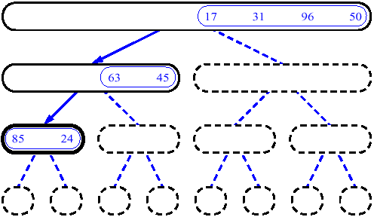
MergeSort (Example) - 3

Slide 10
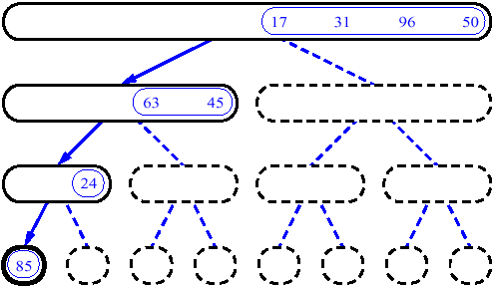
MergeSort (Example) - 4

Slide 11
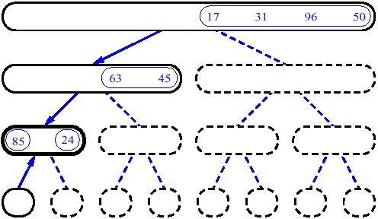
MergeSort (Example) - 5

Slide 12
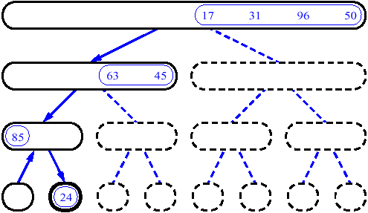
MergeSort (Example) - 6

Slide 13
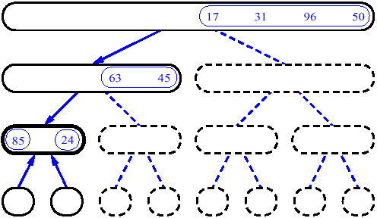
MergeSort (Example) - 7

Slide 14
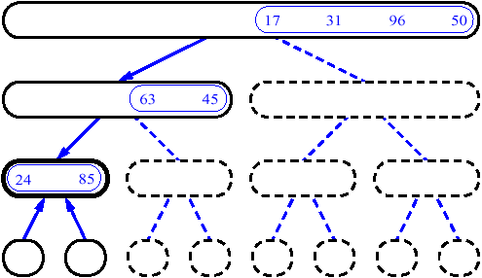
MergeSort (Example) - 8

Slide 15
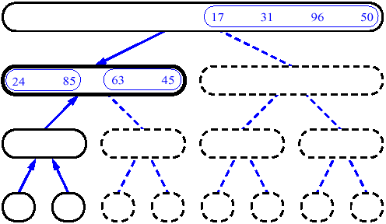
MergeSort (Example) - 9

Slide 16
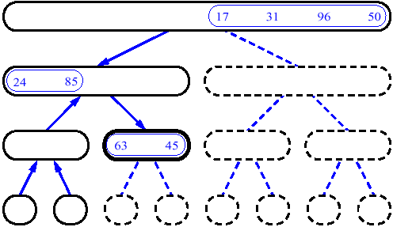
MergeSort (Example) - 10

Slide 17
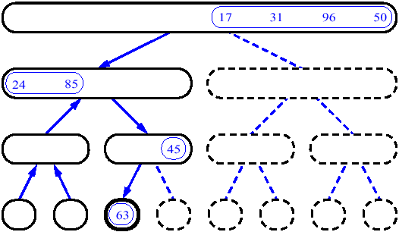
MergeSort (Example) - 11

Slide 18
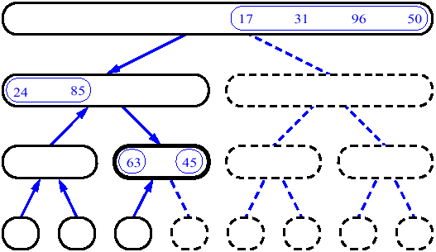
MergeSort (Example) - 12

Slide 19
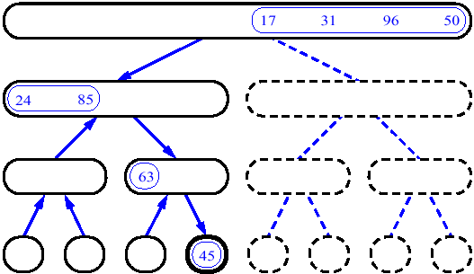
MergeSort (Example) - 13

Slide 20
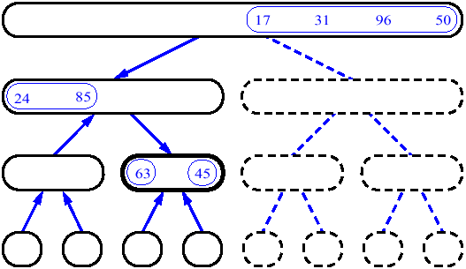
MergeSort (Example) - 14

Slide 21
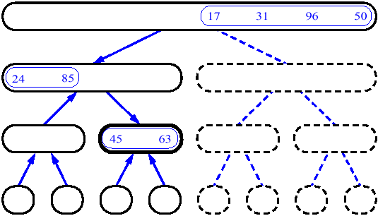
MergeSort (Example) - 15

Slide 22
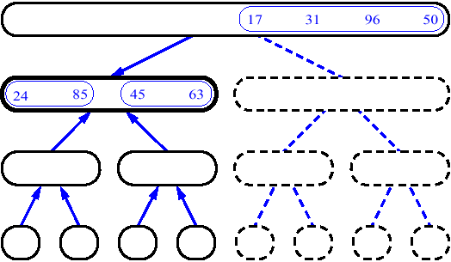
MergeSort (Example) - 16

Slide 23
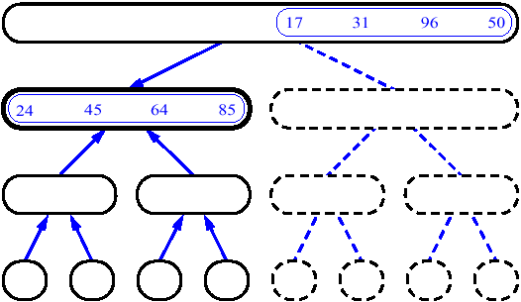
MergeSort (Example) - 17

Slide 24
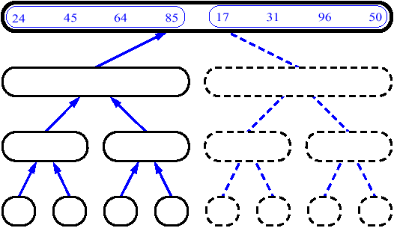
MergeSort (Example) - 18

Slide 25
The merge
Sec. 1.3
Walk through the two arrays simultaneously, in time linear in the total number of elements
2
4
8
16
128
2
4
8
16
32
64
128
Array 1
32
64
1
2
5
8
13
21
34
Array 2
1
2
3
5
8
13
21
34
3
If list lengths are x and y, merge takes O(x+y) operations.

Slide 26
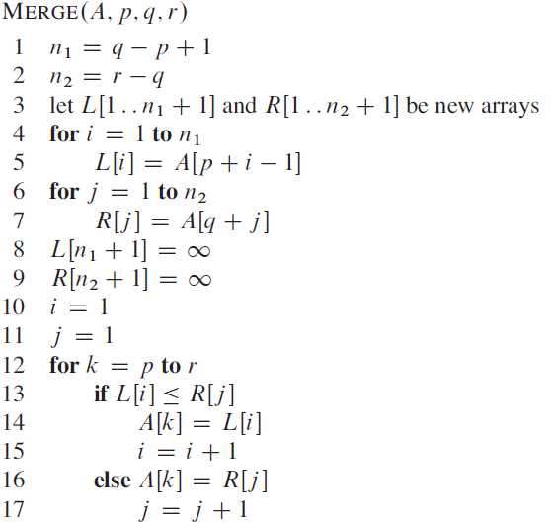

Slide 27
Analyzing Divide-and-Conquer algs.
When the algorithms contains recursive calls, the running time is described by a recurrence equation or just recurrence.
For an input size n, let T(n) be the running time:
we divide the problem into a parts of size b
Let D(n) be the time to divide
Let C(n) be the time to merge,

Slide 28

Analyzing Divide-and-Conquer algs.
For an input size n, let T(n) be the running time:
we divide the problem into a parts of size b
Let D(n) be the time to divide
Let C(n) be the time to merge,
Merge Sort:
Divide: Assuming input of even length
Conquer: for two subproblems,
Combine:

Slide 29

Merge Sort
We shall show that
Merge sort vs. Insertion Sort

